Slide 1
Evan McKenzie
Electrical Engineering Intern – RM1
Summer 2022

Slide 2
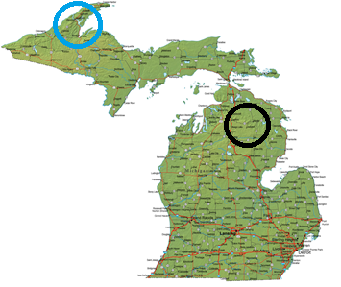


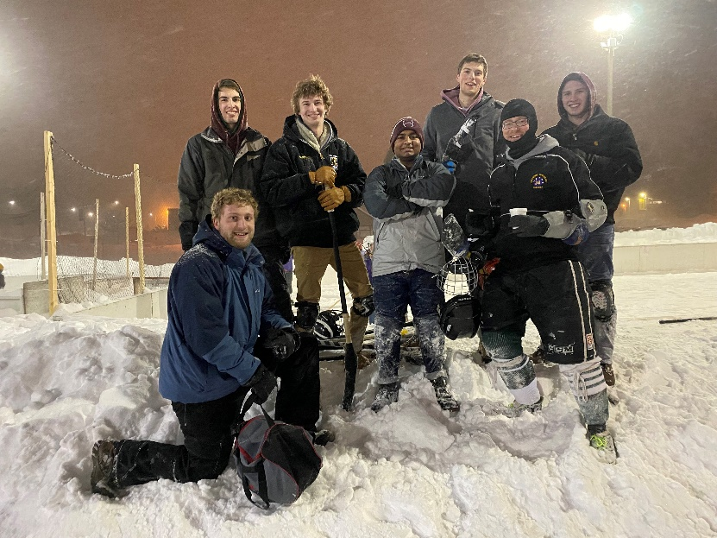
Background
Computer Engineering Major at Michigan Technological University
Graduating December 2022
Originally from Lewiston, MI
Enjoy golfing, broomball/hockey, backpacking, and film photography
Worked Process Automation at Cleveland-Cliffs in summer 2021 before transitioning to Nucor

Slide 3
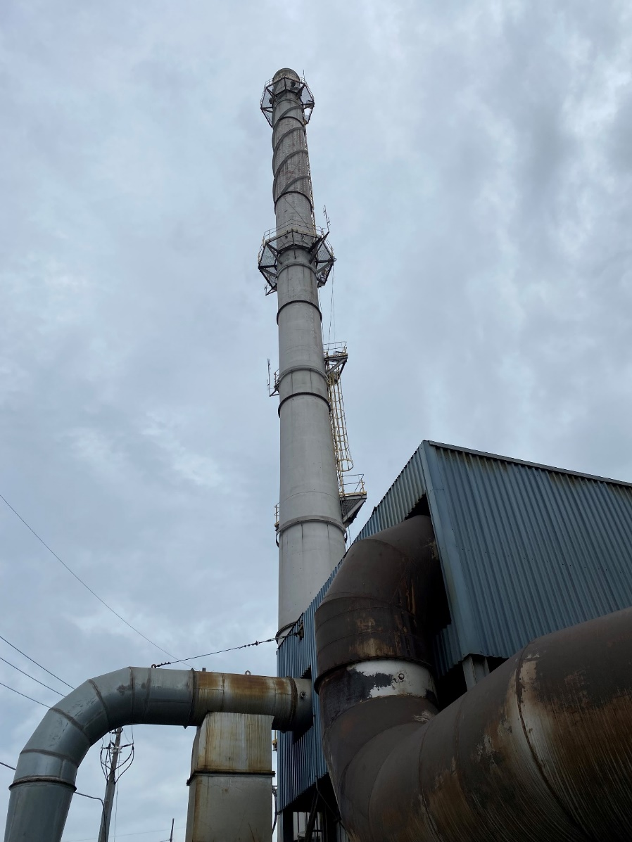
Summer Goals
Become more familiar with electrical maintenance standard practices
Spend more time hands-on in the mill
Apply the theory based skills from college to a real world project
Learn about Nucor as a whole

Slide 4
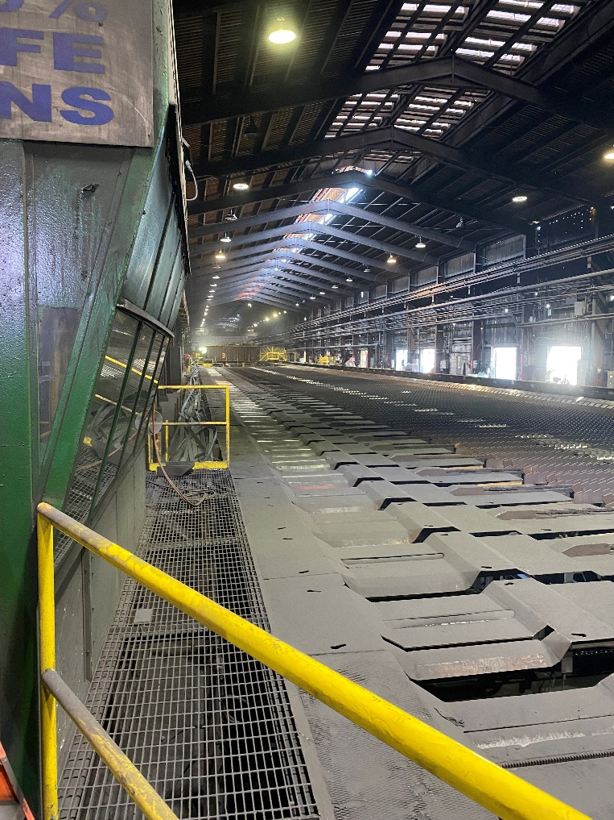
Getting Started
Initially started the summer off following RM1 shift electricians around to get a feel for the mill
Attended additional safety trainings (ladder safety, LOTO, etc.)
Took basic PLC courses to learn the Rockwell software suite/PLC programming basics

Slide 5
Project 1: RM1 Electrical Shop PLC Trainer
Goal: Build a PLC to allow RM1 electricians to become familiar with/get experience with PLC programming
Isolated from the rest of the plant, safe to make mistakes and learn from them
1 AC Input, 1 AC Output, 1 DC Input, 1 DC Output cards to practice connecting and configuring different devices

Slide 6
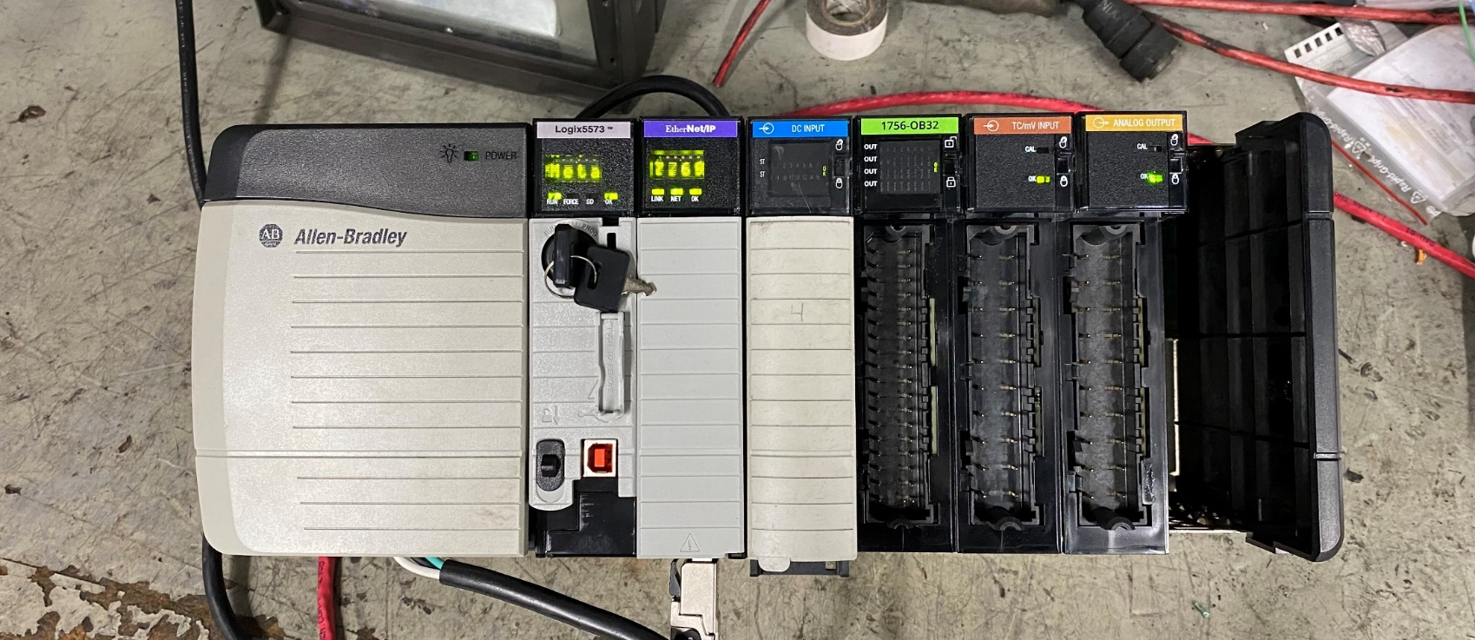
Project 1 Current State and Next Steps
Currently running in our electrical shop, needs three terminal blocks to have all cards operational but otherwise good to go

Slide 7
Project 2: CCL Sample Rack Measurement
Metallurgists want to measure the cooling rate of samples taken at CCL versus how bundles cool in the stack
Build enclosure with Flex I/O and connect to stacker PLC
Attach thermocouples to the outside of sample tubes to measure heat inside the tubes
Add switches to determine when samples are added and removed from rack

Slide 8
Project 2 Goal and Scope
Compare and contrast cooling rates and property differences between samples and finished product
Have a historical record for different products to adjust properties
Can also be connected to Test Lab HMI’s for real time temp monitoring
Eventually expand these measurements to angles as well

Slide 9
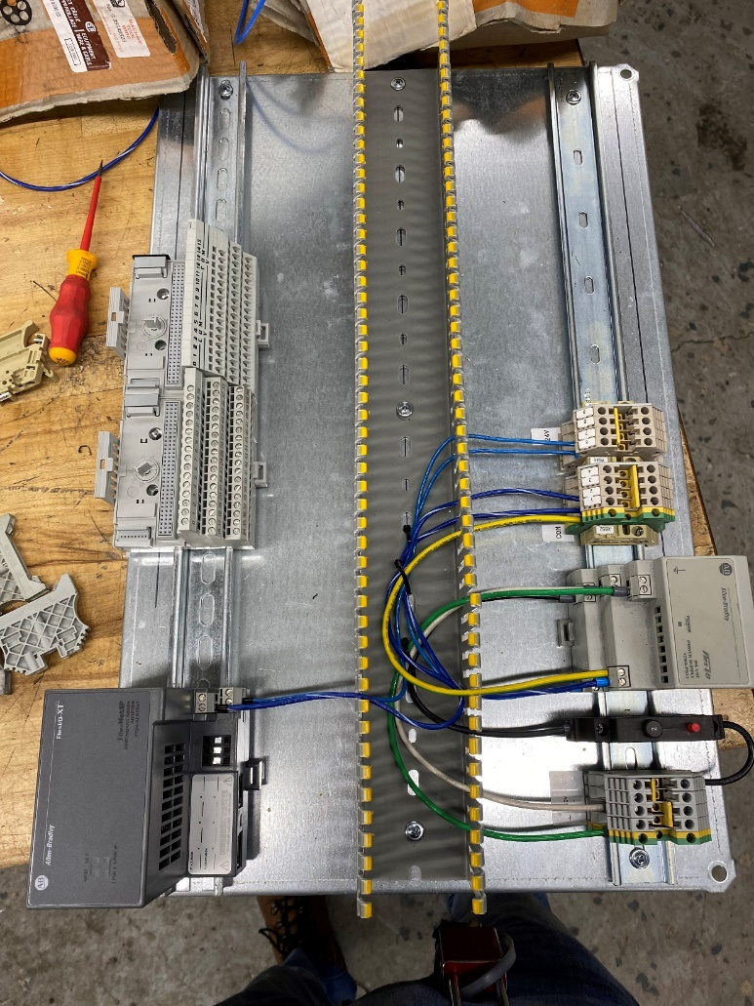
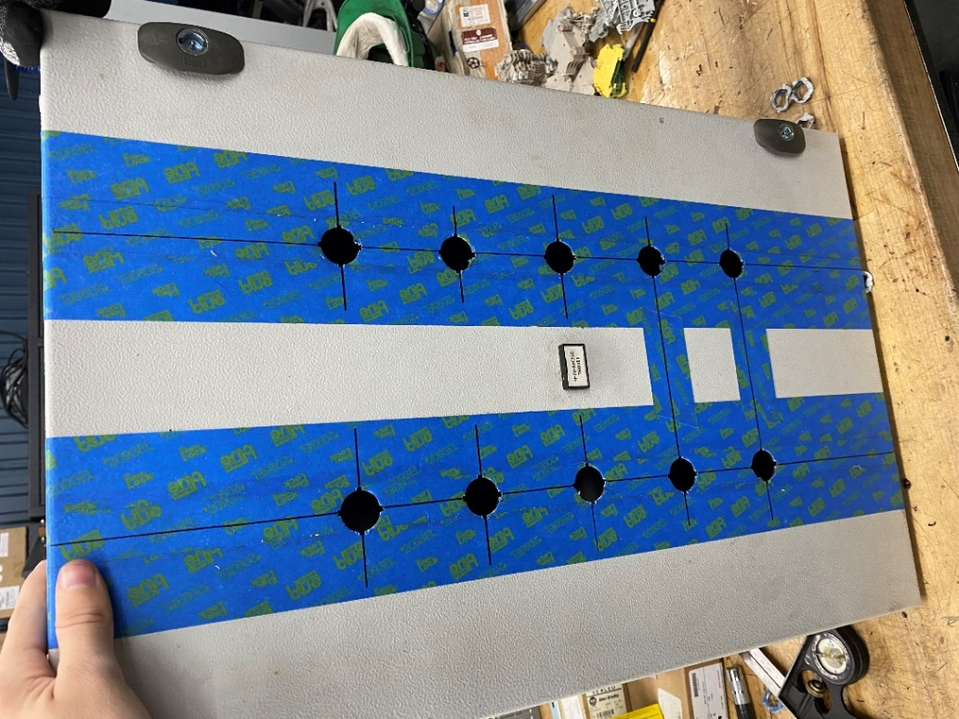
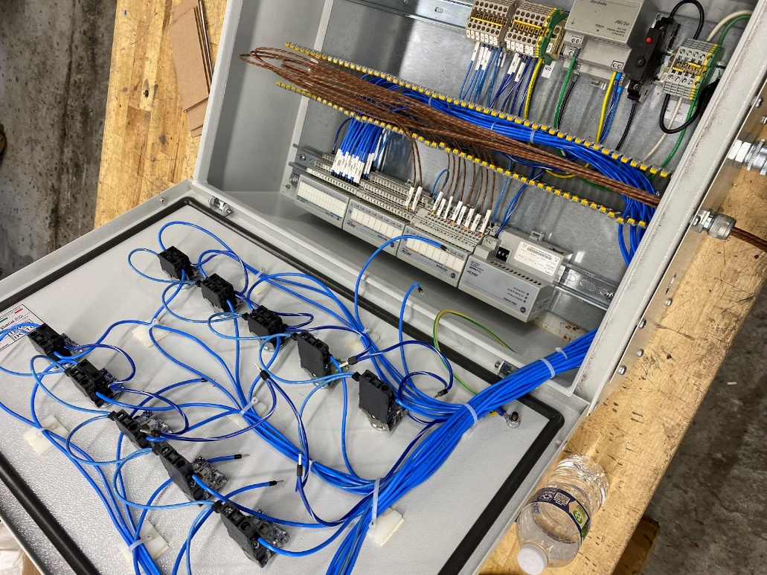
Project 2 Progression
Drilling holes for the switches
Ethernet and power supply wiring
Connecting thermocouples and switch/LED combos

Slide 10
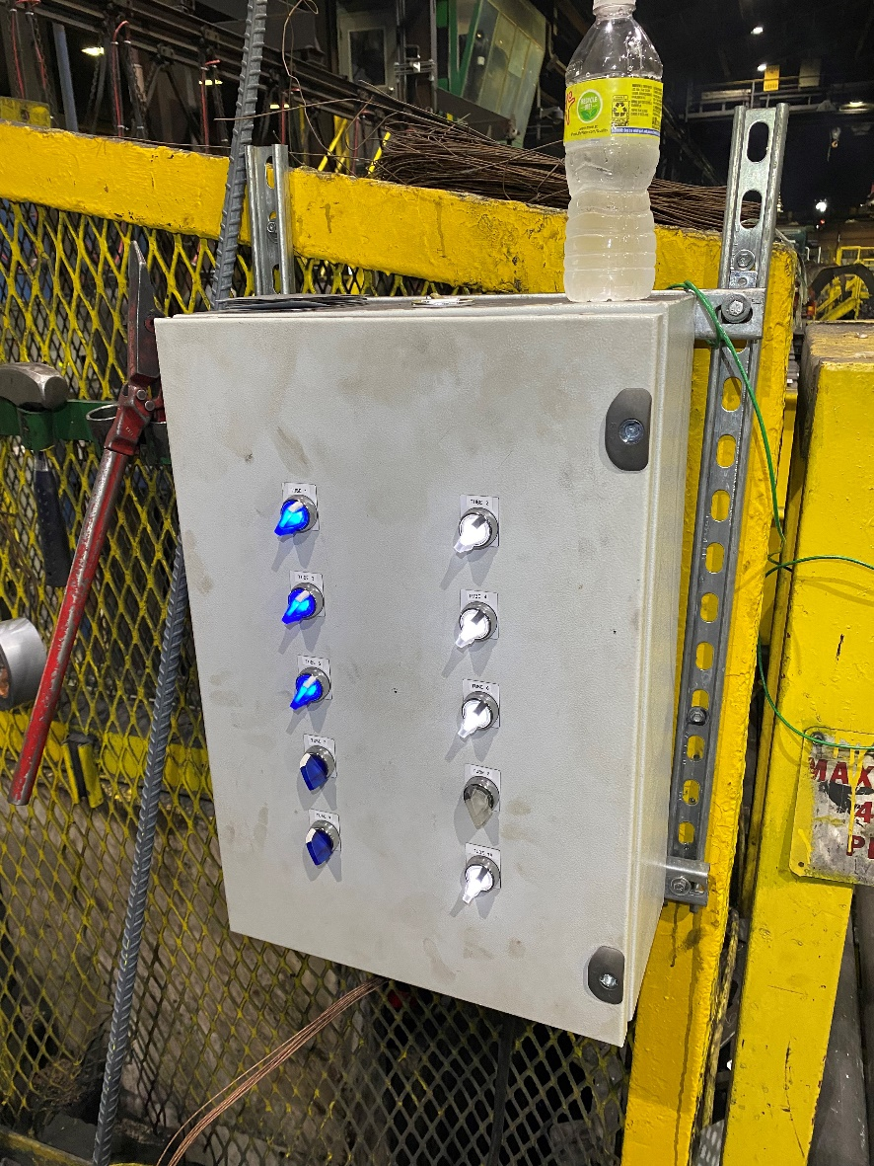
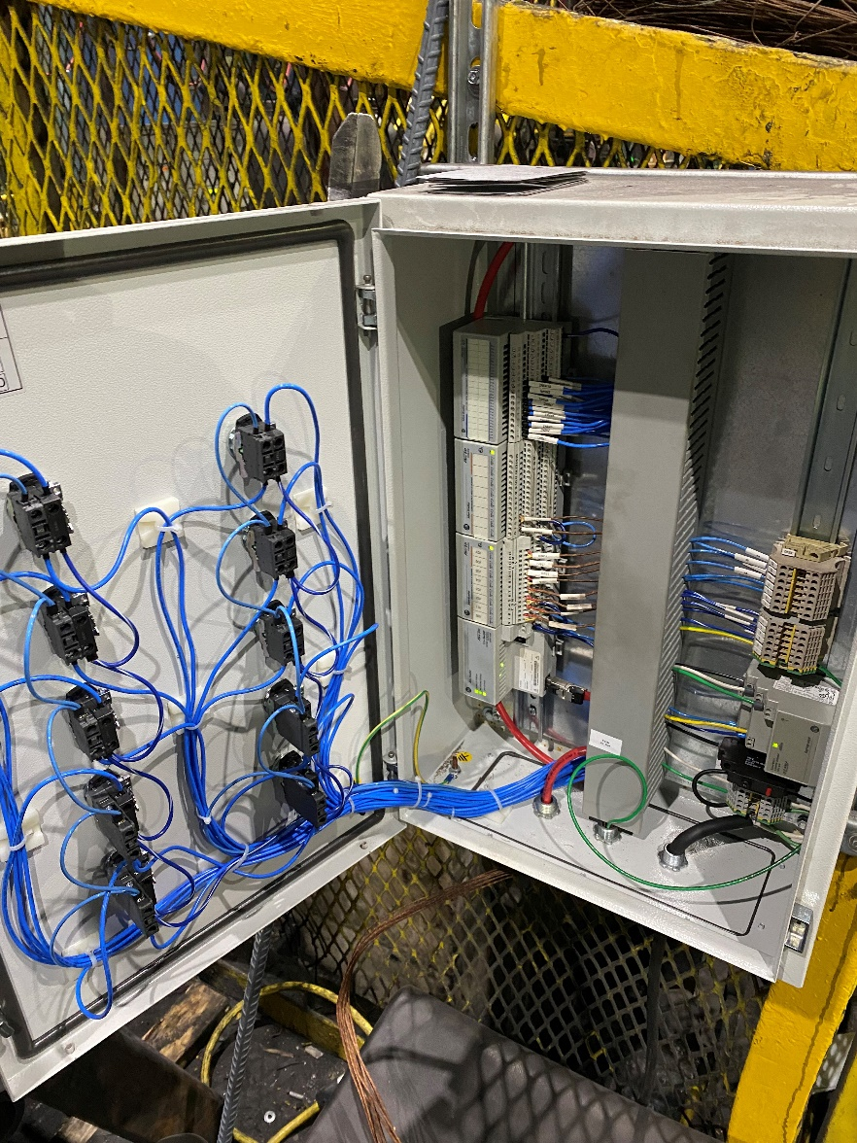
Project 2 Finalization
Once everything was wired up inside the enclosure, Ethernet and power were ran to the box
Switches light up when thrown, visual indicator of sample present

Slide 11
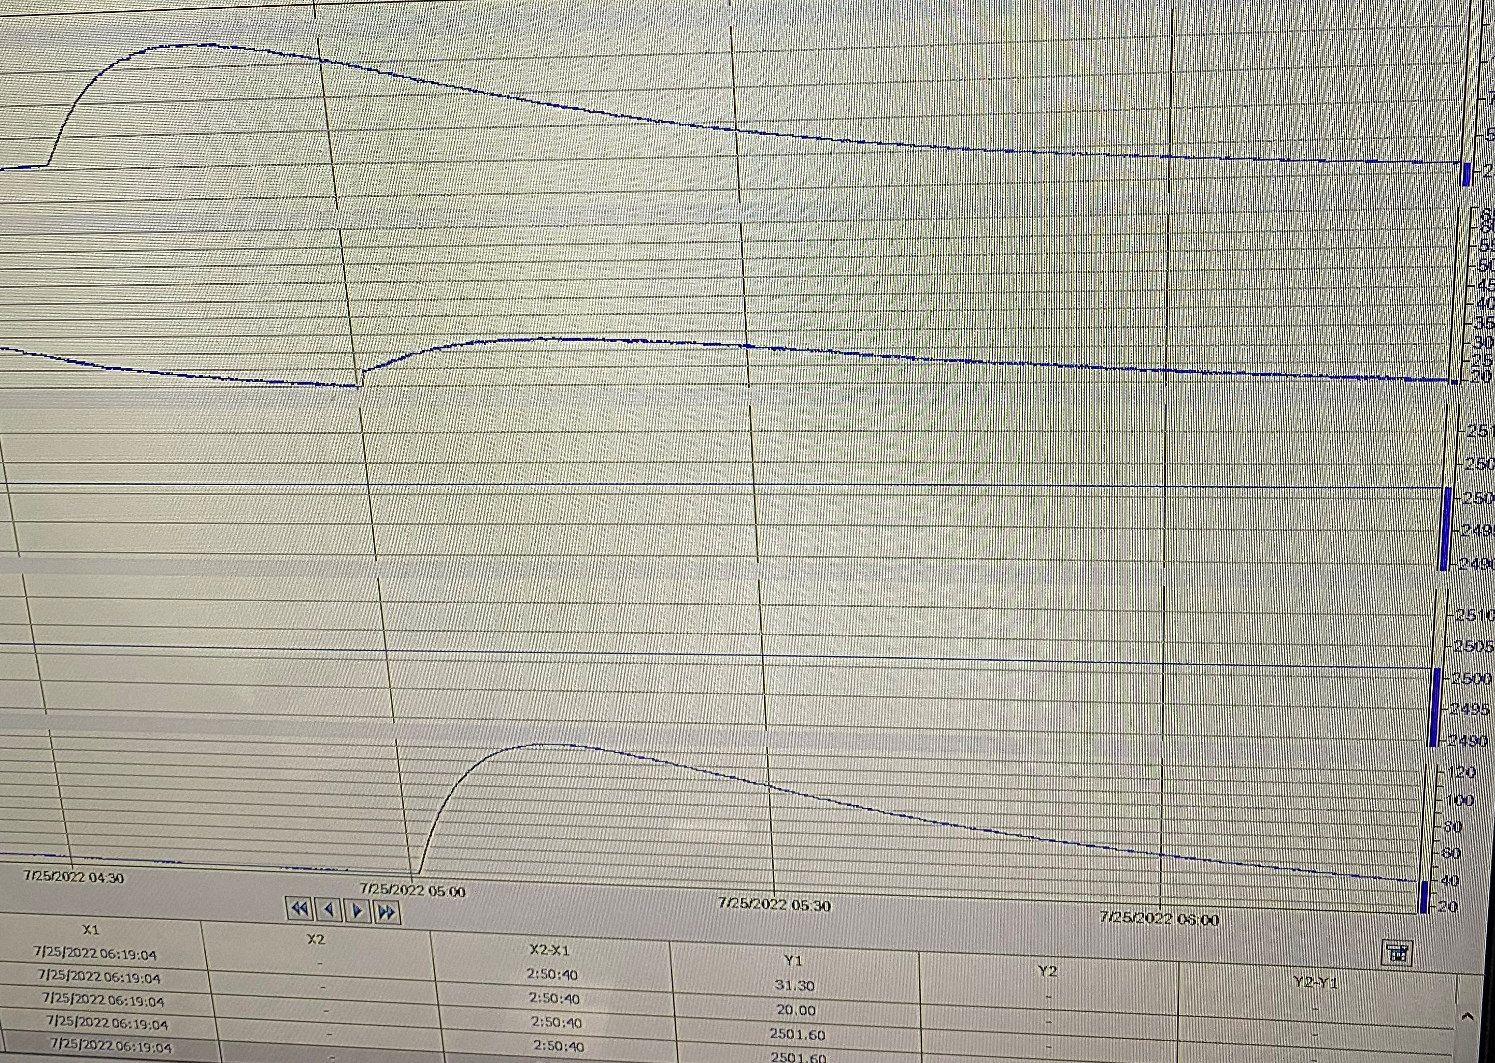
Project 2 Data
Initial trend line for sample cooling
Quick increase in heat followed by slow decrease as the sample cools down
Switches necessary to see when tube is cooling back to ambient

Slide 12
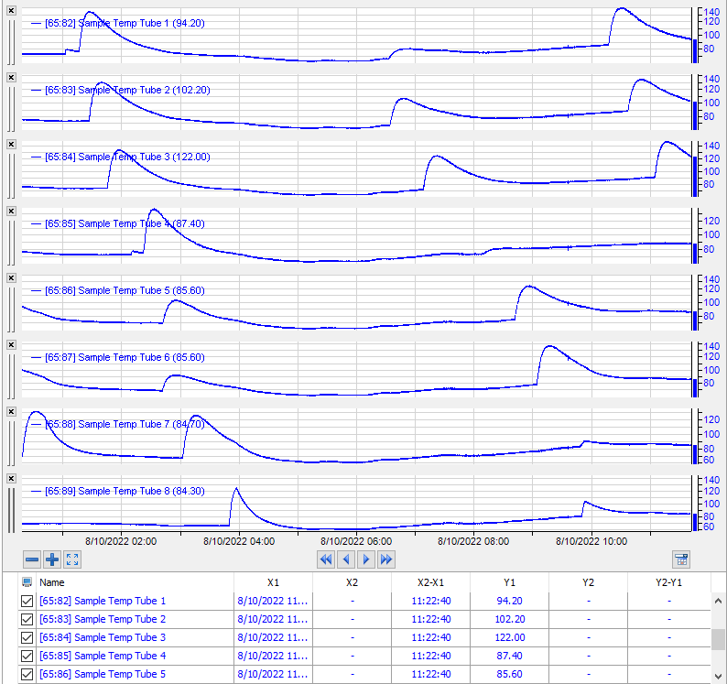
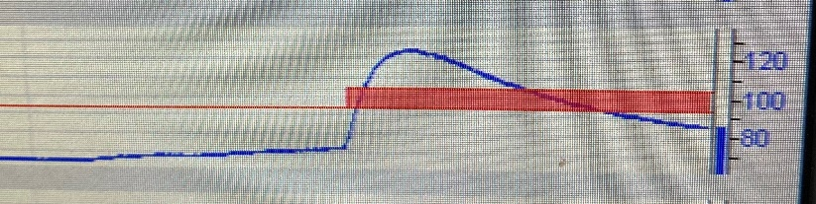
Project 2 Data Continued
Finalized trend lines for all connected tubes
IBA tracking makes it easy to spot any samples with unusual properties
8/9/22 4-bar samples

Slide 13
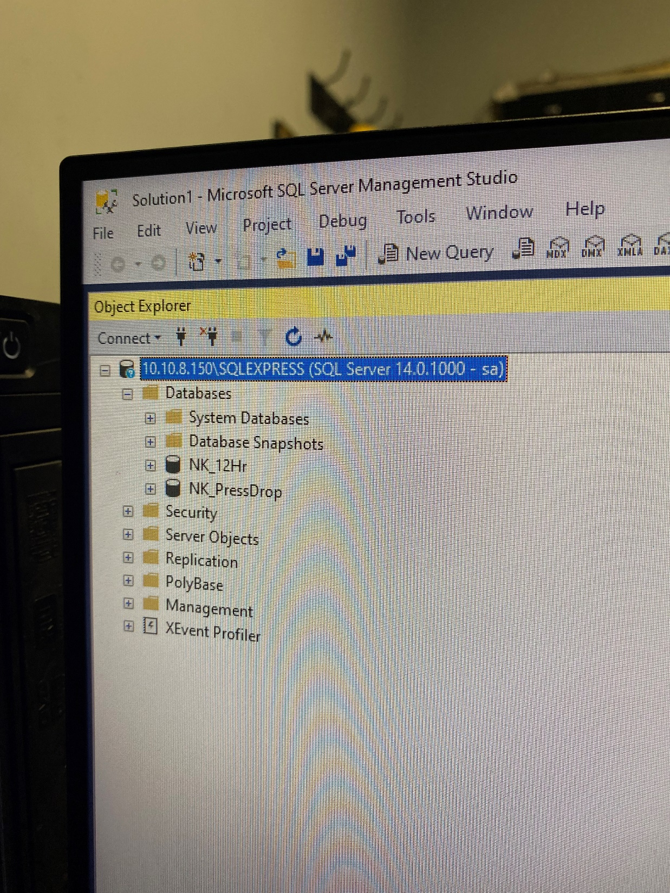
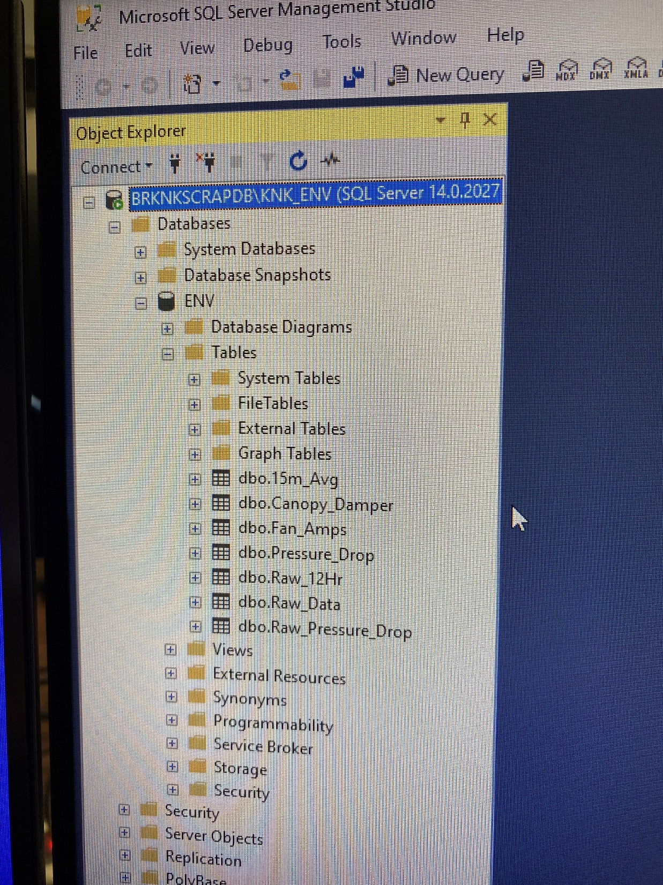
Project 3: Melt Shop Environmental Data Distribution
The Environmental group needs data from the Melt Shop about certain parameters on the baghouse dampers, fan amps, and pressure drops
Segregated networks between these two areas make it difficult to pass this information easily
Two separate databases with similar information hosted on different networks

Slide 14
Project 3 Initial Solution
Excel spreadsheet shared between ENV and IBA databases to import historical data
Fixes to the Excel sheet’s connection information brought it back online
Issues: Manual, hosted on VM, and takes a long time to load data since we are pulling from 2018-present
A better solution would be an automated system like the production emails

Slide 15
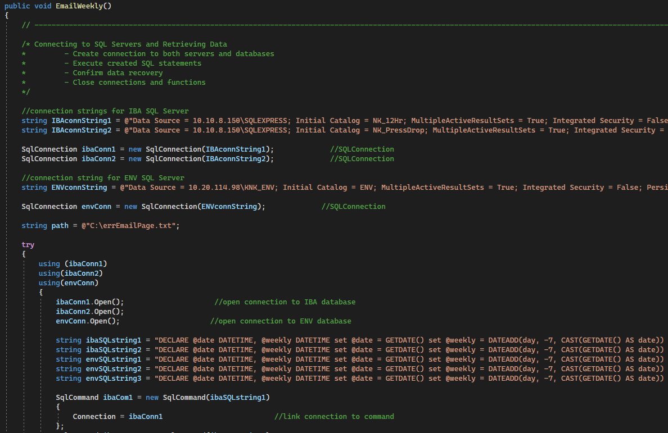
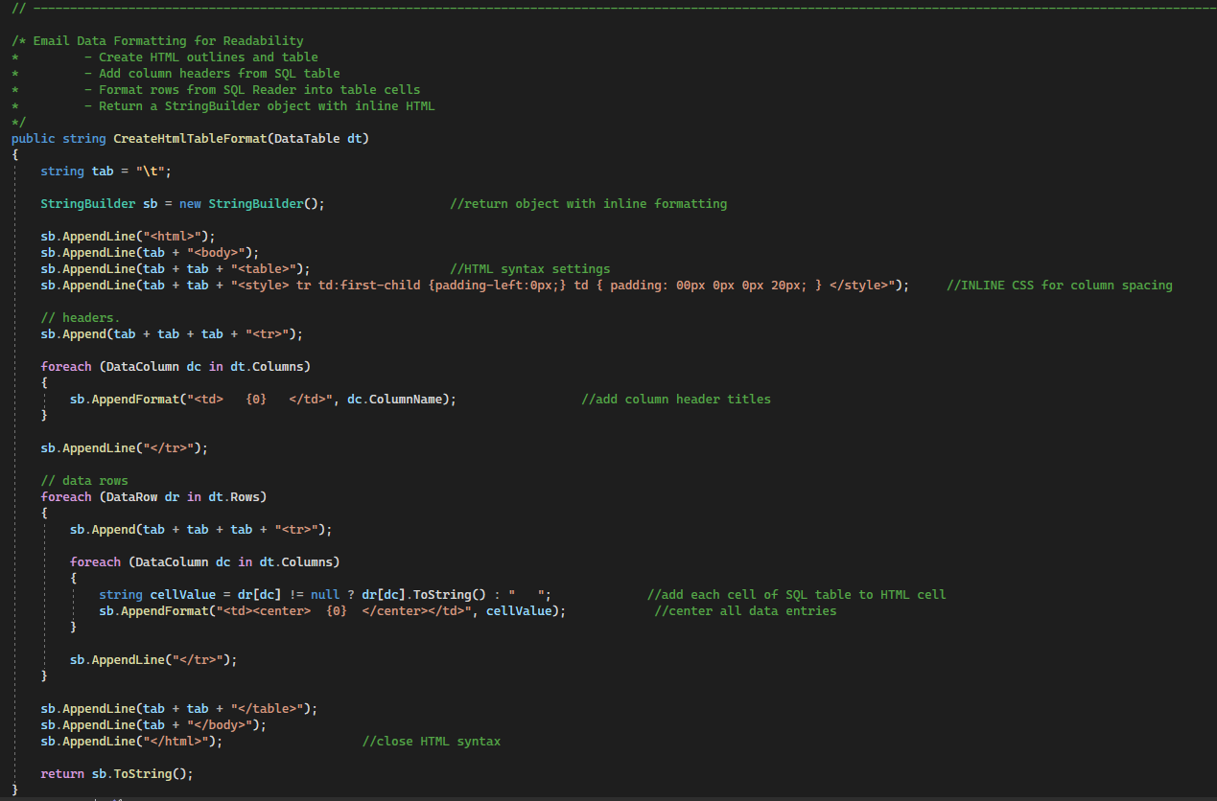
Project 3 Final Solution
Windows Service/Scheduled Task that pulls data from SQL servers and emails that data on a weekly basis (Sunday 9PM)

Slide 16
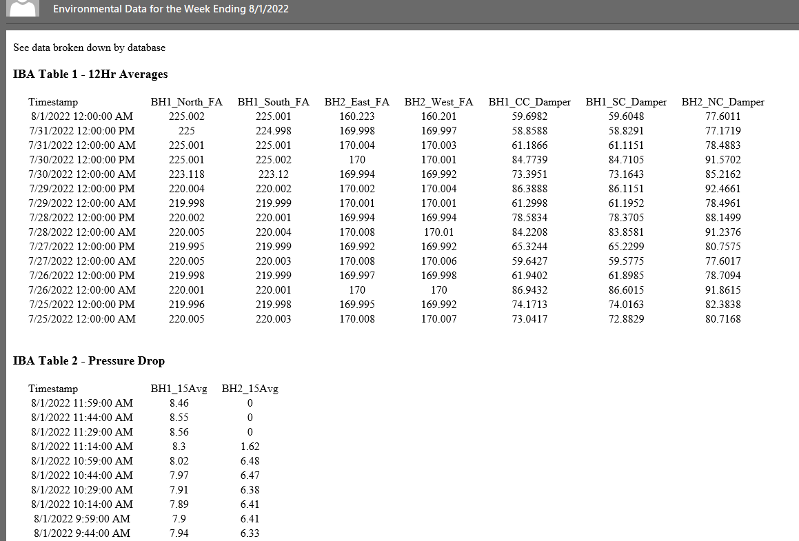
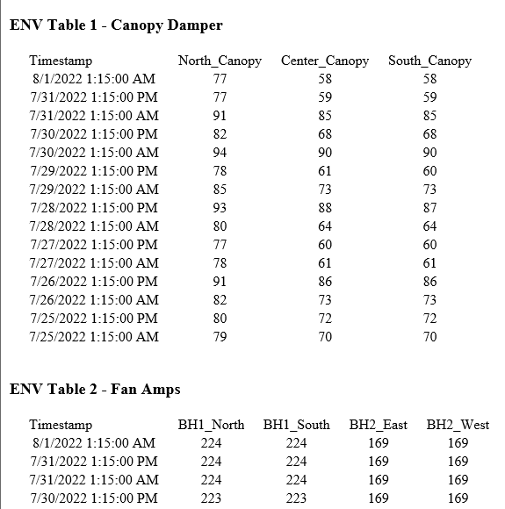
Project 3 Data

Slide 17
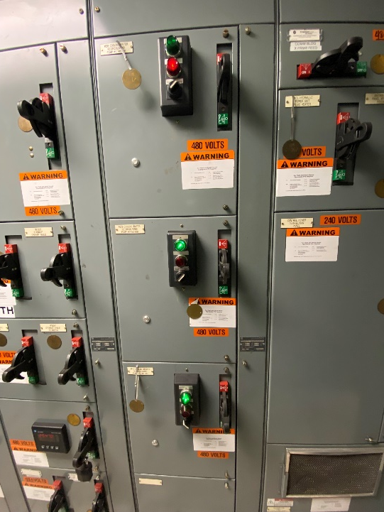
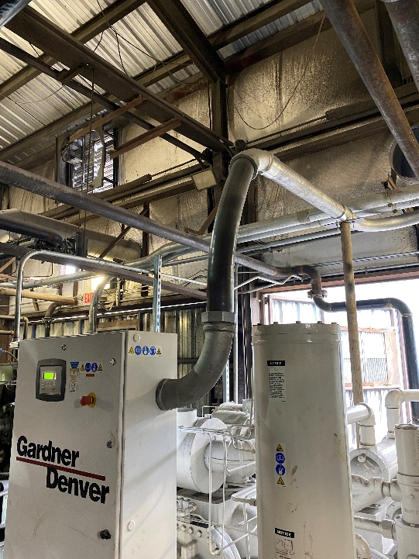
Helped With
CCL Fan Removal/Camera Install
Cooling Tower Pump Alarms
Pump 5 Motor Replacement
Compressor Room Conduit
Melt Shop Network Troubleshooting

Slide 18
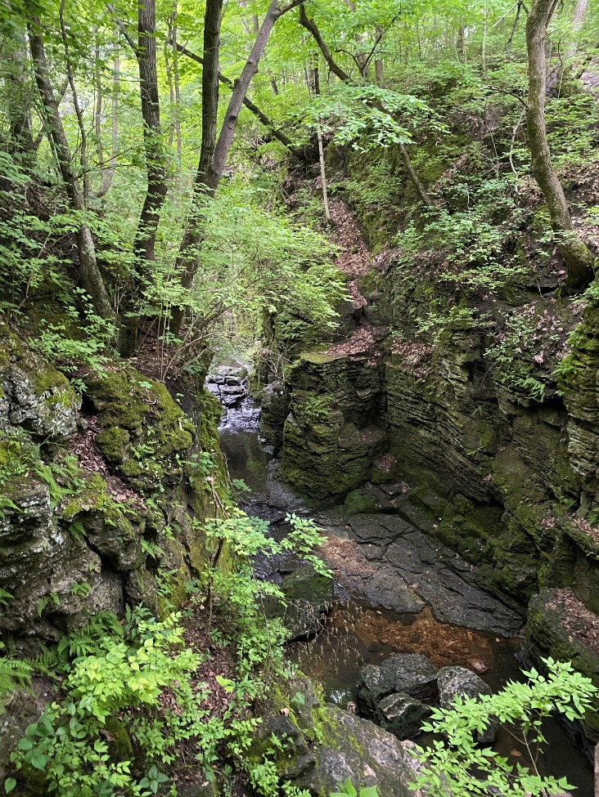
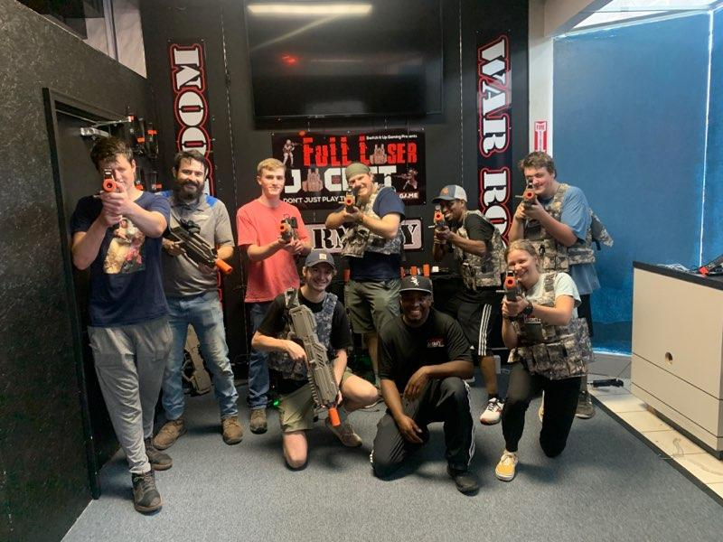
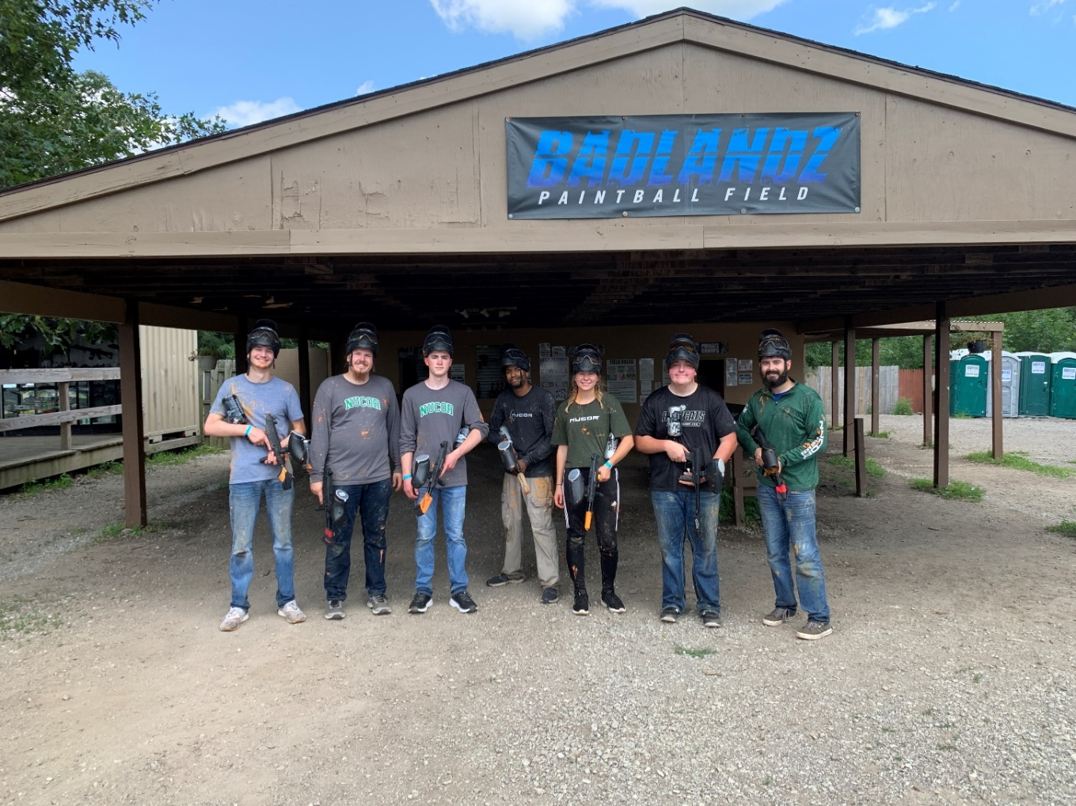
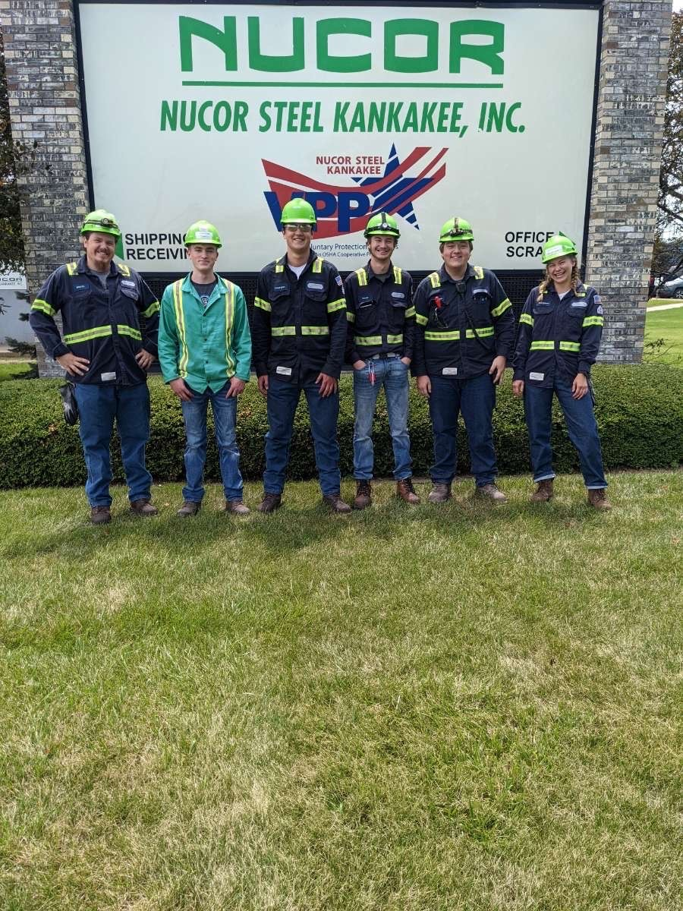
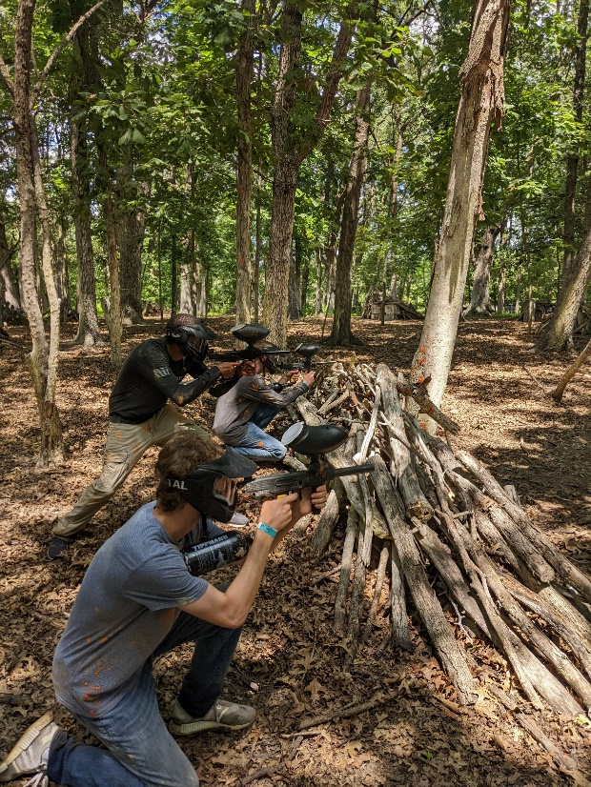
Outside of Work – Living our Culture

Slide 19
Biggest Takeaways
Cannot compromise on safety
A better understanding of production electrical maintenance and standard practices
Increased automation experience, both software and hardware based
Teamwork and good communication keeps us running

Slide 20
Special Thanks
The Entire RM1 Electrical Team
Mike Fritz
Nick Hansen
Jordan Turner and Alex Lopez
My fellow interns

Slide 21
Questions?

